Slide 1
Unit-1
Introduction to ML
Prepared By: Arjun Sing Saud
Asst. Prof. CSCSIT, TU

Slide 2
What is Machine Learning?
Machine learning is an application of AI that enables systems to learn and improve from experience without being explicitly programmed.
Machine learning focuses on developing computer programs that can access data and use it to learn for themselves.
The machine learning process begins with observations or data, such as examples, direct experience or instruction.

Slide 3
What is Machine Learning?
It looks for patterns in data so it can later make inferences based on the examples provided.
The primary aim of ML is to allow computers to learn autonomously without human intervention or assistance and adjust actions accordingly.

Slide 4
How Machine Learning Works?
Learning system of a machine learning algorithm into three main parts.
A Decision Process: In general, machine learning algorithms are used to make a prediction or classification. Based on some input data, which can be labelled or unlabeled, your algorithm will produce an estimate about a pattern in the data.

Slide 5
How Machine Learning Works?
An Error Function: An error function serves to evaluate the prediction of the model. If there are known examples, an error function can make a comparison to assess the accuracy of the model.
An Model Optimization Process: If the model can fit better to the data points in the training set, then parameters are adjusted to reduce the discrepancy between the known example and the model estimate. The algorithm will repeat this evaluate and optimize process, until a threshold of accuracy has been met.

Slide 6
Applications of ML
We are using machine learning in our daily life even without knowing it such as Google Maps, Google assistant, Alexa, etc. Below are some most trending real-world applications of Machine Learning:
Image Recognition: It is used to identify objects, persons, places, digital images, etc. The popular use case of image recognition and face detection is, Automatic friend tagging suggestion.

Slide 7
Applications of ML
Speech Recognition: Speech recognition is a process of converting voice instructions into text, and it is also known as Speech to text, or Computer speech recognition. Google assistant, Siri, and Alexa are using speech recognition technology to follow the voice instructions.
Traffic Prediction: If we want to visit a new place, we take help of Google Maps, which shows us the correct path with the shortest route and predicts the traffic conditions.

Slide 8
Applications of ML
Product Recommendations: Machine learning is widely used by various e-commerce and entertainment companies such as Amazon, Netflix, etc., for product recommendation to the user.
Self-driving Cars: Machine learning plays a significant role in self-driving cars. Tesla, the most popular car manufacturing company is working on self-driving car.

Slide 9
Applications of ML
Email Spam and Malware Filtering: Whenever we receive a new email, it is filtered automatically as important, normal, and spam. The technology behind this is Machine learning.
Online Fraud Detection: Machine learning is making our online transaction safe and secure by detecting fraud transaction. Outlier detection approach is primarily used in fraud detection.

Slide 10
Applications of ML
Stock Market Trading: Machine learning is widely used in stock market trading. Time series prediction ML models are used for the prediction of stock market trends.
Medical Diagnosis: In medical science, machine learning is used for diseases diagnoses.
Machine Translation: Machine Learning algorithms are helpful in translating text from one language to another. The technology behind the automatic translation is a sequence to sequence learning algorithm.

Slide 11
Machine Learning Methods
Machine learning methods fall into three primary categories: Supervised, Unsupervised, and Reinforcement.
Supervised Learning:
In this learning paradigm, we present examples of correct input-output pairs to the ML algorithms during the training phase.
This training set of examples is equivalent to the teacher for the ML algorithms.

Slide 12
Machine Learning Methods
During the training of ML algorithm under supervised learning, the it takes input vector and computes output vector.
An error signal is generated, if there is a difference between the computed output and the desired output vector.
On the basis of this error signal, the model parameters are adjusted until the actual output is matched with the desired output.

Slide 13
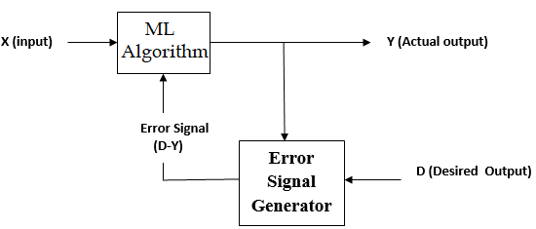
Machine Learning Methods
Supervised machine learning is used for performing tasks like: Regression and Classification.

Slide 14
Machine Learning Methods
Unsupervised Learning
In unsupervised learning ML algorithm is provided with dataset without desired output.
The ML algorithm then attempts to find structure in the data by extracting useful features and analyzing its structure.
Unsupervised learning algorithms are widely used for tasks like: clustering, dimensionality reduction, association mining etc.

Slide 15
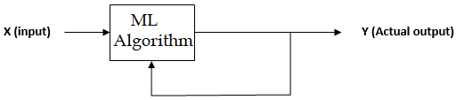
Machine Learning Methods
Reinforcement Learning
In reinforcement learning, we do not provide the machine with examples of correct input-output pairs, but we do provide a method for the machine to quantify its performance in the form of a reward signal.

Slide 16
Machine Learning Methods
Reinforcement learning methods resemble how humans and animals learn: the machine tries a bunch of different things and is rewarded with performance signal.
Reinforcement learning algorithms are widely used for training agents interacting with its environment.

Slide 17
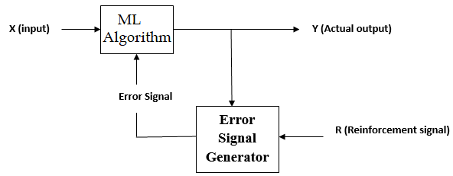
Machine Learning Methods

Slide 18
Data Objects and Attribute Types
Types of Attributes
On the basis of set of possible values attributes can be divided into following types
Nominal Attributes
Ordinal Attributes
Interval-scaled Attributes
Ratio-scaled Attributes

Slide 19
Data Objects and Attribute Types
Nominal Attributes
The values of a nominal attribute are symbols or names of things.
Each value represents some kind of category, code, or state, and so nominal attributes are also referred to as categorical. The values do not have any meaningful order.
Examples of nominal attributes:
Hair_color: possible values are: {black, brown, red, grey, white}

Slide 20
Data Objects and Attribute Types
Nominal Attributes
Marital_status: possible values are:{Married, Single, Divorced, Widowed}
Customer_ID: possible values are: Combination of numbers
It is possible to represent such symbols with numbers. With hair_color, for instance, we can assign a code of 0 for black, 1 for brown, and so on. However, in such cases, the numbers are not intended to be used quantitatively.

Slide 21
Data Objects and Attribute Types
Ordinal Attributes
An ordinal attribute is an attribute with possible values that have a meaningful order or ranking among them, but the magnitude between successive values is not known.
Examples of ordinal attributes:
Grades: possible values are: {A+, A, A-, B+, B, B- and so on}
Height: possible values are:{Tall, Medium, Short}

Slide 22
Data Objects and Attribute Types
Ordinal Attributes
The values have a meaningful sequence (which corresponds to increasing height ); however, we cannot tell from the values how much bigger, say, a medium is than a short.
Note that nominal, and ordinal attributes are qualitative. That is, they describe a feature of an object without giving an actual size or quantity.
We can compute median and mode of ordinal attributes. However, we cannot compute mean.
But, we can only compute mode of nominal attributes.

Slide 23
Data Objects and Attribute Types
Interval-Scaled Attributes
Interval-scaled attributes are numeric attributes. A numeric attribute is quantitative; that is, it is a measurable quantity, represented in integer or real values.
The values of interval-scaled attributes have order and can be positive, 0, or negative. Thus, in addition to providing a ranking of values, such attributes allow us to compare and quantify the difference between values.
Because interval-scaled attributes are numeric, we can compute their mean value, in addition to the median and mode measures of central tendency.

Slide 24
Data Objects and Attribute Types
Interval-Scaled Attributes
A temperature attribute is interval-scaled. Suppose that we have the outdoor temperature value for a number of different days, where each day is an object. By ordering the values, we obtain a ranking of the objects with respect to temperature.
In addition, we can quantify the difference between values. For example, a temperature of 20⁰C is five degrees higher than a temperature of 15⁰C.
Calendar dates are another example. For instance, the years 2002 and 2010 are eight years apart.

Slide 25
Data Objects and Attribute Types
Interval-Scaled Attributes
Temperatures in Celsius and Fahrenheit do not have a true zero-point, that is, neither 0⁰C nor 0⁰F indicates “no temperature.”
Although we can compute the difference between temperature values, we cannot talk of one temperature value as being a multiple of another.
Without a true zero, we cannot say, for instance, that 10⁰C is twice as warm as 5⁰C. That is, we cannot speak of the values in terms of ratios. Similarly, there is no true zero-point for calendar dates.

Slide 26
Data Objects and Attribute Types
Ratio-Scaled Attributes
A ratio-scaled attribute is a numeric attribute with an inherent zero-point.
That is, if a measurement is ratio-scaled, we can speak of a value as being a multiple (or ratio) of another value.
In addition, the values are ordered, and we can also compute the difference between values, as well as the mean, median, and mode.
Temperature in Kelvin, length, counts, elapsed time, etc. are examples of ratio scaled attributes

